Slide 1
The French and Indian War
Part 4-
Tensions Rise

Slide 2
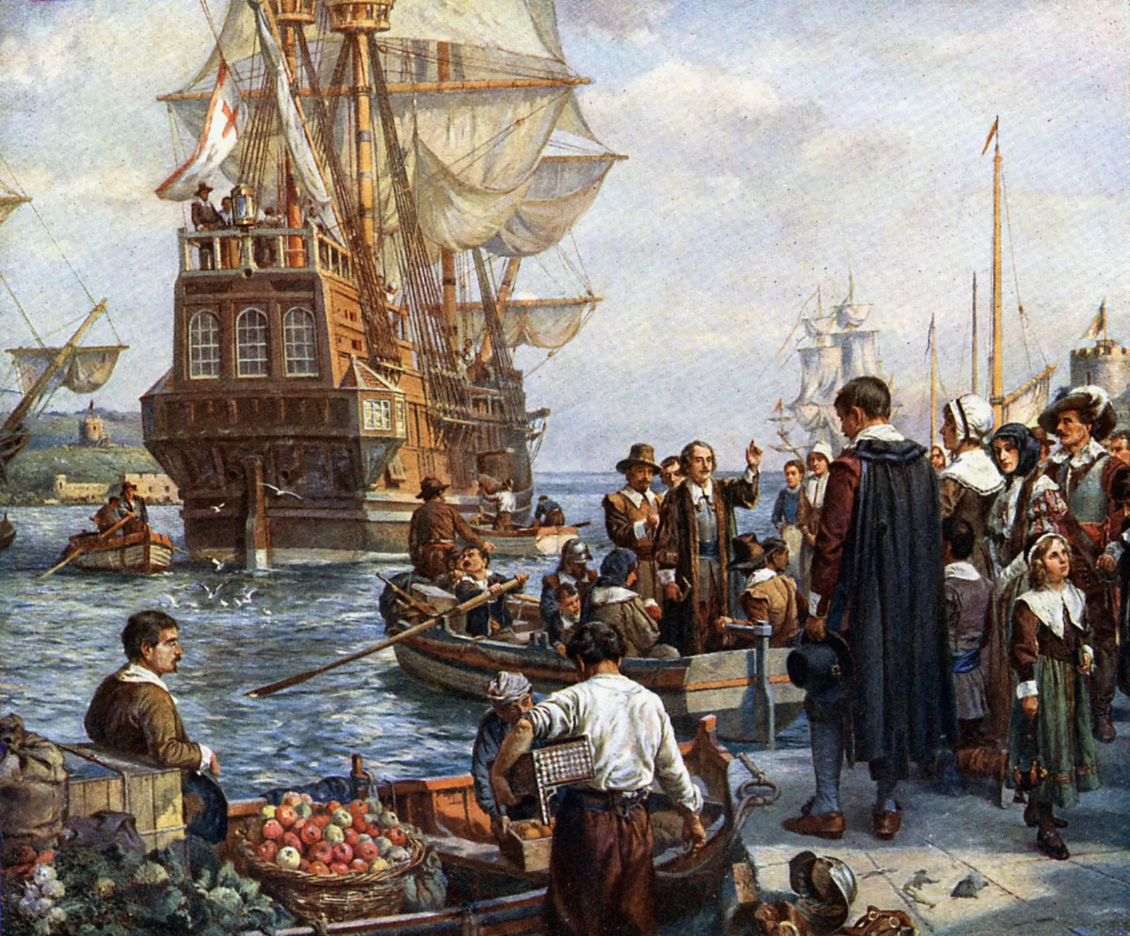
By 1750, there were about 80,000 French colonists living in North America. In comparison, there were over 1,000,000 British colonists.

Slide 3
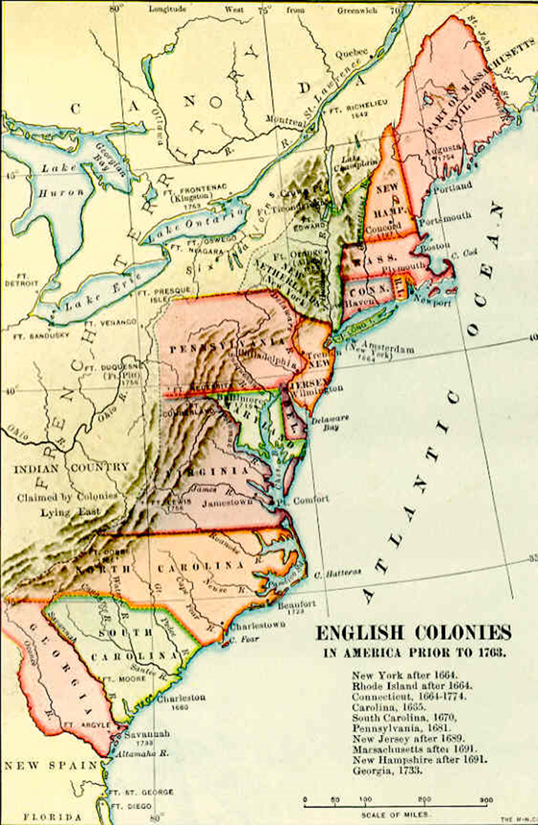
The Ohio Company of Virginia made plans to help settle British colonists west of the Appalachian Mountains in the Ohio River Valley.

Slide 4
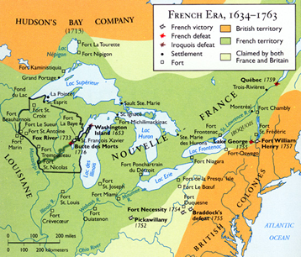
The French also claimed the land in the Ohio River Valley.

Slide 5
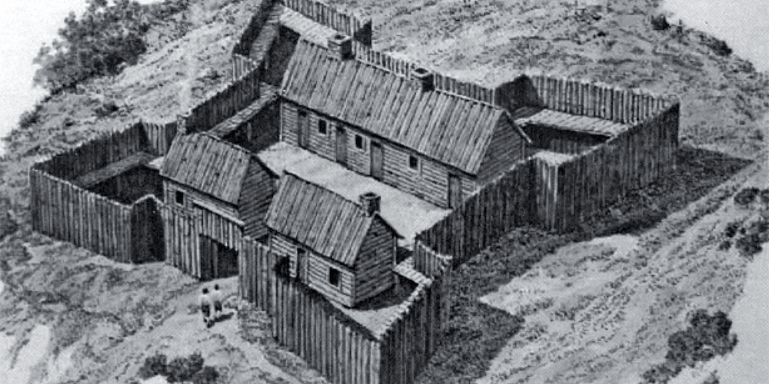
To stop the British colonists from moving into the Ohio River Valley, the French started building forts in the area.

Slide 6
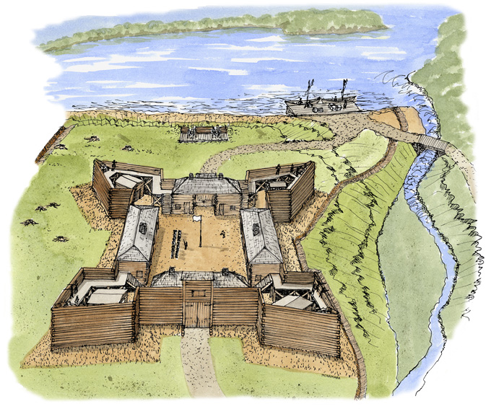
In 1753 the French built Fort Presque Isle (Erie) and Fort Le Boeuf (Waterford).

Slide 7
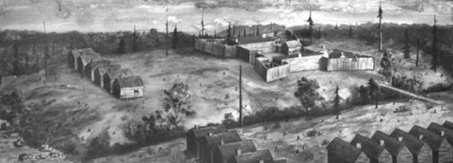
Fort Machault was built in 1754 by the French near the junction of French Creek and the Allegheny River.

Slide 8
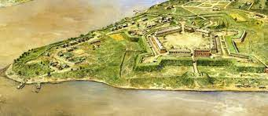
In 1754 they built Fort Duquesne where the Allegheny and Monongahela Rivers meet to form the Ohio River. (Pittsburgh)

Slide 9
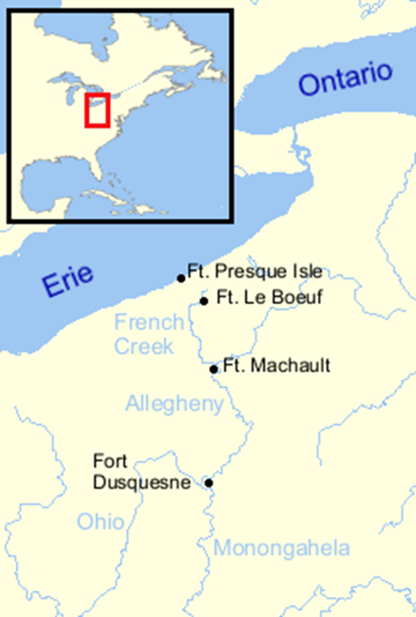
Why do you think these are a good locations for forts?

Slide 10
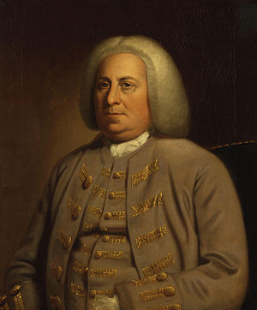
The governor of the Virginia colony, Robert Dinwiddie, wanted the land of the Ohio River Valley for Virginia.

Slide 11
*Remember, the colonies did not have the same borders in the 1750s as our states do today.

Slide 12
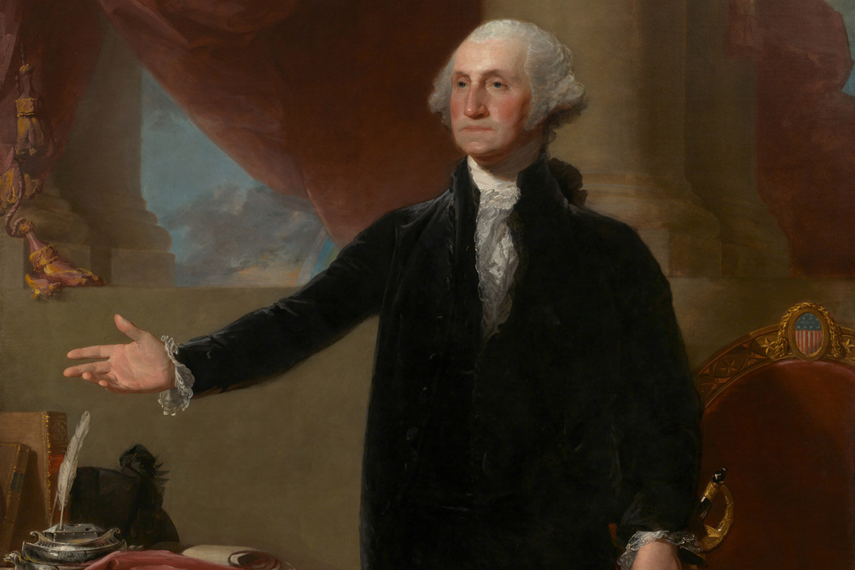
What do you know about George Washington? With a partner, come up with a list of what he is known for.

Slide 13
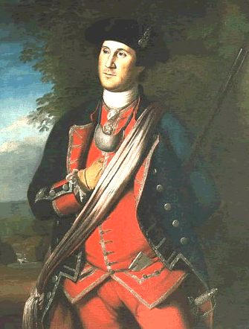
Dinwiddie sent a young man from the British army named George Washington to Fort Le Boeuf to tell them to leave. The French refused.

Slide 14
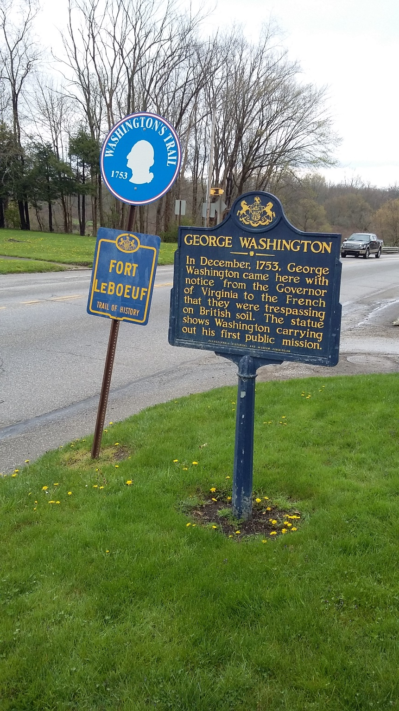
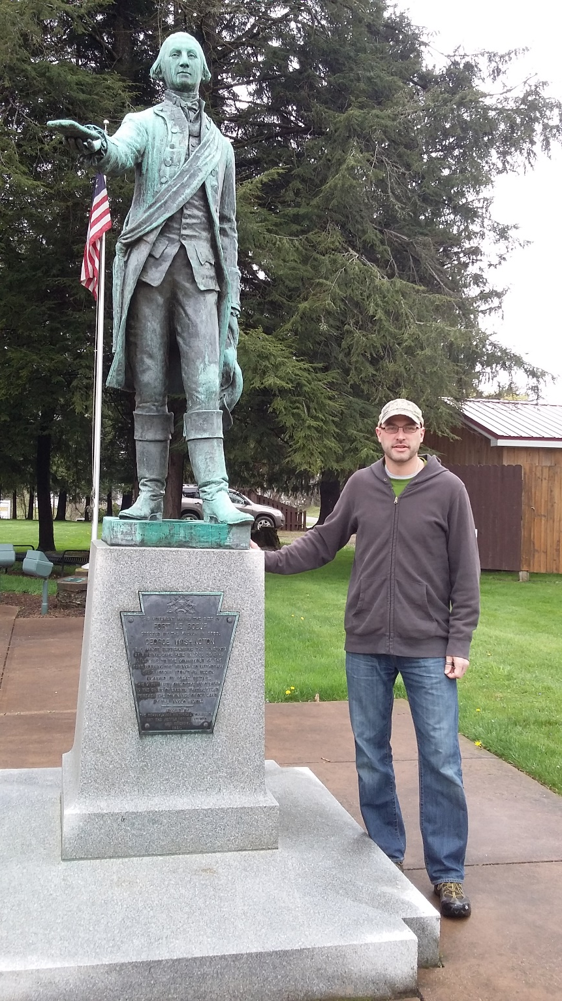

Slide 15
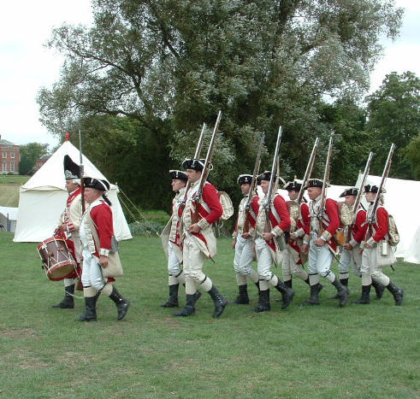
Several months later, Washington was sent back to the area with soldiers to protect British colonists in the area and drive the French out.

Slide 16
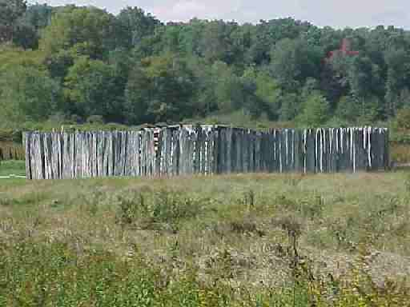
Worried about being attacked by a larger French force from Fort Duquesne, Washington built Fort Necessity for protection.

Slide 17
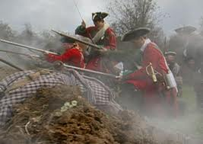
On July 3, 1754, the French did attack, laid siege to the fort, and forced Washington to surrender.

Slide 18
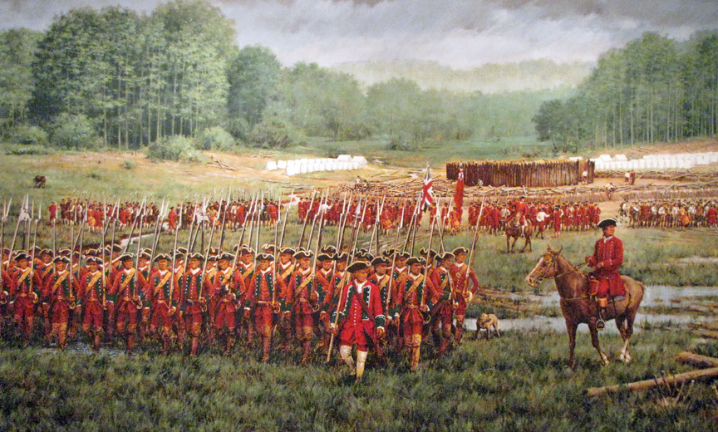
Washington and his troops returned to Virginia. Many say this was the beginning of the French and Indian War.

Slide 19
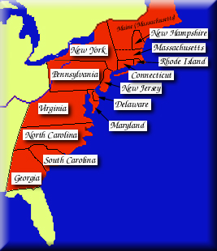
Several British colonists understood that like the Iroquois they would be better off if the British colonies worked together.

Slide 20
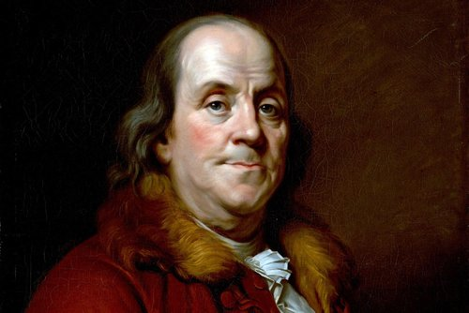
One of these was a Philadelphia printer named Ben Franklin. He printed the first political cartoon in America titled Join or Die to make the point that the British colonies should join together for their mutual defense.

Slide 21
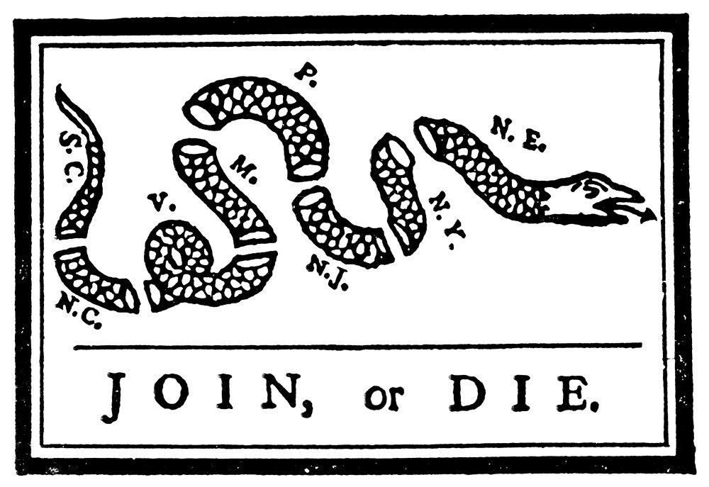

Slide 22
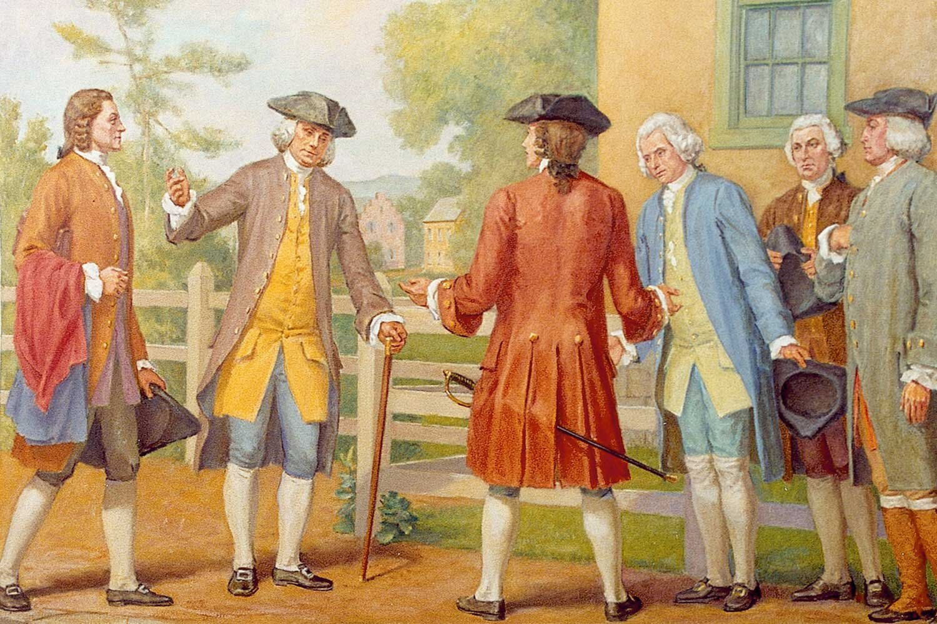
So in 1754, colonial leaders from seven colonies, along with many Iroquois leaders met in Albany and formed the Albany Congress to form a plan of union.

Slide 23
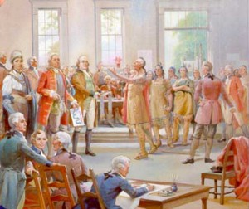
However, the colonies rejected the Albany Plan of Union because none of the colonies wanted to give up power to a central government.

